Slide 1
Introduction to Optimization Techniques
EEE 417
Onur Ümit Şener
2006102010

Slide 2
Wavelet Transform
A mathematical technique that decomposes signals using short, localized waves called wavelets.

Slide 3
Wavelet Transform
Key Features:
Wavelets: Small waves that analyze different parts of a signal.
Scaling & Translation: Adjust wavelet size and position to capture both high and low-frequency details.
Time-Frequency Localization: Provides information about signal features in both time and frequency.

Slide 4
Wavelet Neural Networks
A type of neural network that integrates wavelet transform for enhanced signal processing and pattern recognition

Slide 5
Wavelet Neural Networks
Key Features:
Wavelet Nodes: Combine wavelet transform with neural network nodes for better feature extraction.
Multi-Resolution Analysis: Captures detailed and global patterns in data.
Adaptive Learning: Learns wavelet parameters during training for optimized performance.

Slide 6
Wavelet Neural Networks
Applications:
Signal processing, image analysis, time-series prediction, anomaly detection.
Advantages:
Improved performance on non-stationary and complex signals.
Enhanced capability for capturing localized and global features.

Slide 7
Wavelet Transform in my code
def apply_wavelet_transform(data, wavelet='db1'):
transformed_data = []
for image in data:
coeffs2 = pywt.dwt2(image, wavelet)
LL, (LH, HL, HH) = coeffs2
transformed_data.append(np.stack([LL, LH, HL, HH], axis=-1))
return np.array(transformed_data)
LL: Approximation coefficients.
LH: Horizontal detail coefficients.
HL: Vertical detail coefficients.
HH: Diagonal detail coefficients.

Slide 8
Minibatch Optimization
Starts random
Selected window
Gradient
My own function

Slide 9
Minibatch Optimization
SGD w/ Moment-Calculated Loss
Time per Epoch
Previous Cost - Current Cost
Learning Rate
Tanh
Abs
Epoch³
delta = learning_rate*(cost-new_cost)
gradient = np.tanh(delta)*np.abs(delta)*(epoch**3)
new_batch_size = batch_size + gradient

Slide 10
My Function
Let,
α be the learning rate
Δ be the delta
𝐶 be the current cost
𝐶′ be the new cost
ε be the current epoch
𝑏 be the current batch size
𝑏’ be the new batch size
G be the Gradient
Δ = α(𝐶 − 𝐶′)
G = tanh(Δ) ⋅ ∣Δ∣ ⋅ ε³
𝑏′ = 𝑏 + G

Slide 11
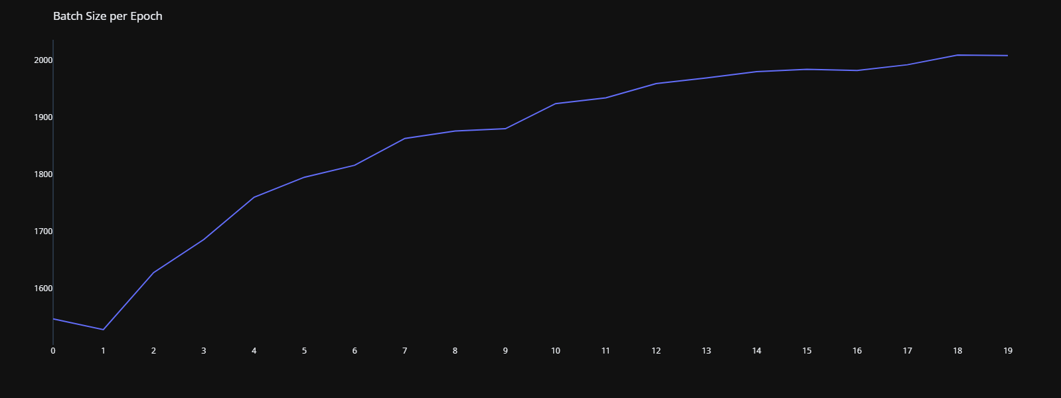
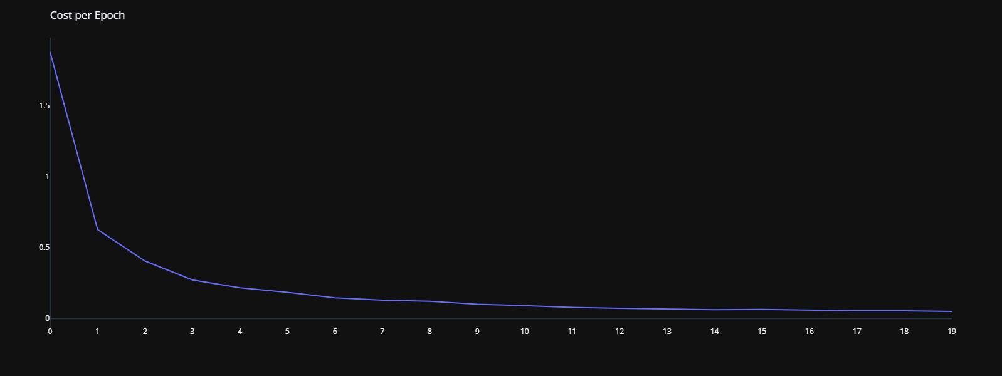
Results
Worked as intended
It compromises speed at first few epochs.
After the loss drops, It goes for the faster batch size.

Slide 12
Time and Loss Comparison
Dynamic Batch Size
1024
2048
Time:
53.412s
Accuracy:
98.58%
Time:
48.435s
Accuracy:
98.25%
Time:
44.804s
Accuracy:
98.62%

Slide 13
Critique of the Technique
Benefits
Downsides
Looks after better Loss
Counters the decreasing Loss by using epoch in the function
Extremely dynamic
Random number shows it can work with any size of batches
Gets faster overtime
Works worse as the Loss gets smaller
Might get unstable if Loss difference is enormous
Can be affected by CPU speed
Random number determines the convergence
Having a fixed size might be faster

